Slide 1
Supporting children as they settle at school
MENTAL HEALTH SUPPORT TEAM (MHST)
Emotional Health Service
Achieving for Children
42 York Street
London TW1 3BW

Slide 2
Notes:
Sam - 1 min
I’m… and I work for the Mental Health Support Team - hereafter referred to as the MHST.
The MHST is an early intervention, multi disciplinary team of clinical specialists, mental health clinicians and education wellbeing practitioners (EWP) - of which I’m one - who provide mental health support to children, young people, families/carers and staff in school settings, within Kingston and Richmond. The teams work for Achieving for Children as part of the Emotional Health Service.

Slide 3
What might this look like in my child’s school?
An Education Wellbeing Practitioner offering 1-1 brief guided self-help interventions for parents of children with mild to moderate anxiety or behaviour difficulties
Offering Art and Music Therapy
Group-work and workshops with groups of children
Workshops for parents and school staff
For more information, speak to your class teacher or the school’s Mental Health Lead
Notes:
Both (introducing roles and offer) - 2 mins
The MHST involvement in school varies at different times of the year depending on the school’s identified needs…
It might look like…
An Education Wellbeing Practitioner working in school one day a week, with flexibility for online work
Offering 1-1 brief guided self-help interventions for parents of children with mild to moderate anxiety or behaviour difficulties
May also deliver group-work and workshops with groups of children
Also running workshops for parents and school staff
A family practitioner has also joined our team recently and might also work here some of the year
For more information, speak to your class teacher or the school’s Mental Health Lead:

Slide 4
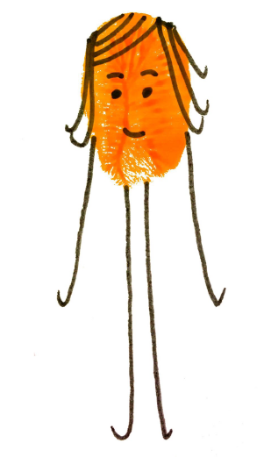
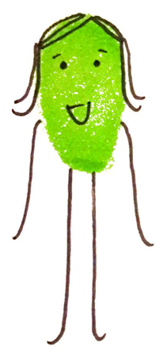
Aims of the session:
Building relationships and security in school
Recognising that skills developed both at home and in school are transferable
We will be thinking about…
Notes:
Zainab - 1 min
So, the aim of today's session is to explore what we could be doing as parents to support our children in building relationships and security in school, as well as spending some time on thinking about the skills children learn at home and school and how these are transferable.

Slide 5
What is school readiness?
Children who are ‘school ready’ have:
the ability to cope emotionally with being separated from parents and carers
relative independence in their own personal care
a curiosity about the world and a desire to learn
strong social skills
(PACEY, 2015)
Notes:
Zainab - 1 min
Often people think children are ready for school if they’ve learned certain academic activities, such as knowing the alphabet or being able to count to a certain number. However, school readiness, while it does include that, is so much more. And it is important to note that what parents and carers do with their children on a daily basis is important for cultivating school readiness but also for future success in school.
By the age of four we would expect children to be ready to be separated from their parent or carer. We would expect them to have enough language to be able to express themselves if they need something and be able to communicate something about what makes them who they are, such as name, age and something about family or relevant factors in their life.
Children at four may also be able to show interest and pay attention to a subject or stimulus. We think that children should be able to focus on, and show interest in, their work and the world around them. To make observations, notice things and ask questions. To be able to hold a book, understand some aspects of narrative and respond to some boundary setting.
And have strong social skills such as listening skills and being able to interact with adults and peers. For example, during play they will be able to take turns and take some responsibility for their actions.
(‘Are you ready? Good practice in school readiness’ OFSTED 2014 a Primary school headteacher)

Slide 6
Transition worries and anxiety:
Starting school can be an anxious time for both parents and children.
Anxiety impairs the ability to:
take in new information and enjoy learning
control attention and stay focused on tasks
get along with other children and adults
Notes:
Sam - 1 min
Transition to school requires children to cope with many changes – expectations put on them, new learning environment, change in daily routines.
It is normal to feel anxious BUT this can impact a child’s ability to cope with the demands of school and learn effectively.
How quickly children adjusts to new setting increases their success so supporting them across the transition is important.
Attachment important in this…

Slide 7
What can help?
…promoting a child’s attachment to school
Notes:
Sam - 1 min
Promoting a child’s attachment to school is the main focus for parents and carers in this transition to Reception
Based on Attachment Theory

Slide 8
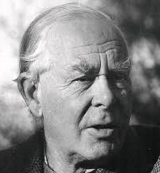
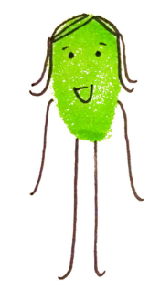
What is attachment?
The “lasting psychological connectedness between human beings” (Bowlby 1969)
Notes:
Zainab - 1 min
Attachment refers to the “lasting psychological connectedness between human beings.” Bowlby 1969 There is plenty of research which shows that the attachment people develop in their romantic and personal relationships reflects the attachment children build develop with their parents. So, providing the care and attention children need to develop a healthy attachment style is really quite important.
In the early stages of a human life, so when we’re babies, humans survive based on the abilities of their caretakers to detect and meet their needs and intentions. In these stages we see that the environment adapts itself to the changing needs of the maturing infant towards achieving autonomy

Slide 9
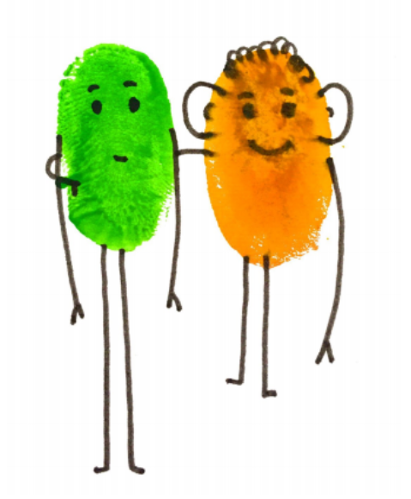
Attachment and relationships
Attachment is…
Co-created
Predictable and consistent
Provides security and safety
Notes:
Zainab - 2 mins
Attachment communication involves visual signals through face-to-face interactions, emotional tone expressed through voice, and body gestures and touches.
Attachment drives brain development which is both “experience-dependent” and “socio-emotional”
Positive experiences alter neural connections in the right brain, promoting emotional well-being.
It calms down distress states and stimulates positive emotions in play states
Impacts on the stress-regulating axis in the brain: the hypothalamic-pituitary-adrenal axis (HPA axis)
The aim of attachment behaviour is to feel closeness or contact with the attachment figure, who is also associated with feelings of security and safety.
Also, it is important to remember that:
Early attachment experiences during infancy influence how the brain develops up until adolescence.
It shapes how we learn to calm our emotions, how we understand ourselves and how we relate to others and the wider world.

Slide 10
The Secure Base
A secure base is provided through a relationship with one or more caregivers who offer a reliable base from which to explore and a safe haven for reassurance when there are difficulties.
Provides sense of security; a feeling of being loved and loveable
Regulation of emotion/arousal through mutuality
Expression of feelings and communication
Base for exploration
Learning cause and effect
Ability to develop other attachments
Notes:
Sam - 3 mins
They could reach out into the world, knowing you would be there to comfort them in times of need.
Secure attachment -
Emotional component -
Carer is reliable source of comfort, able to provide emotional understanding and regulation.
Child then develops ability to express and regulate emotion.
Cognitive component -
Carer is sensitive to child’s expressed needs and able to understand feelings and behaviour.
Child then develops ability to empathise and make sense of others
The secure base:
Provides sense of security; a feeling of being loved and loveable
Regulation of emotion/arousal through mutuality
Expression of feelings and communication
Base for exploration (secure base)
Learning cause and effect
Development of conscience
Ability to develop other attachments
Need to be able to use teacher as a secure base for learning.

Slide 11
School as the secure base
As children’s relationships in school develop and they feel more comfortable, school becomes a secure base:
Providing safety
Providing emotional security in fear-provoking situations
Promotes opportunities for learning, play, socialising and contribution
School becomes a place where children can feel safe to explore and their learning can thrive.
Notes:
Sam- 1 min
In addition to their primary attachment relationship with you, the hope is that your child also forms an attachment to their school and this acts as an additional secure base
Children who are securely attached in the classroom .....
“are able to wait their turn, secure in the fact that the teacher will be able to meet their needs. Their expectations are that interactions with adults will be affirming of their own worth, this frees them to take risks and tolerate frustrations in the learning process.”
Young Minds

Slide 12
School relationships and children’s outcomes
Positive relationships are associated with:
high social competence (problem solving, social skills)
improved achievement (intellectual curiosity, academic performance)
high self-esteem
good relationships with peers as well as adults
ability to manage emotions effectively
engagement in learning
Notes:
Sam - 1 mins
Promoting secure attachment to school (irrespective of parent’s own prior experiences of school) is in the long term best interest of the child.
Young children who develop secure relationships with their teachers, often feel more confident in the caring environment, have enhanced cognitive activity and will be more successful at learning in that environment.

Slide 13
How can you help build this secure base?
Talk about school as a fun and interesting place.
Visual timetables to help establish routine.
Sharing stories - what happened today? What was fun?
Model talking to school staff and share how these interactions make you feel.
Photos of the school/ new teacher.
Get ready for the day ahead together with lots of chat about what’s coming.
Reduce language, and use visual support.
Being aware and curious about sensory sensitivities, noises, group work, Colours/objects/triggers.
Give yourselves extra time in the morning to reduce time pressures so this is a positive time too.
Celebrate Success!
Notes:
Sam - 1 mins
Sharing stories..
What happened today?
What was fun?..
What might be happening tomorrow?
Thinking about relationships…
Talk to your child about their teacher, talk to the teacher when it’s possible.
Ask about friendship

Slide 14
Other skills that will build ‘school readiness’ include:
Autonomy and self care
Managing emotions
Developing empathy
Social skills
Communication skills
Routines
Notes:
Zainab - 1 min
Other skills you can help develop to build school readiness include (read from slide).

Slide 15
Autonomy and self care
What is autonomy and self-care?
Why is this important?
What can you do to support your child with this?
Keep practising at home
Build up gradually
Finding fun way or games such as the ‘flip trick’ for coats
Labelled praise
Tasks to grow independence
Notes:
Zainab - 1 mins
Autonomy is being able to do things on your own. As you all probably know, at home children are used to having everything done for them. However school is a very different environment, it is busy, there are a lot of children, and it requires children to have more autonomy. With a level of autonomy children will be in a better position to look after their emotional wellbeing, which will give them a better chance at engaging with the learning positively impacting on their learning and academic attainment. Autonomy can also increase a child’s confidence and self esteem – increasing their likelihood of trying new things.
What can you do?
Help your child to have a ‘can do’ independent attitude to the following
Toilet
Hand washing
Tissues
Food
Dressing
Putting on coat
Walking rather than pram
Giving up/having set times at home for Dummies/comforters
LINK TO PHYSICAL DEVELOPMENT - These will develop their fine motor control and ability to care for themselves e.g. toileting, dressing, drinking from a cup, using knife and fork.
Activities like catch, kicking and throwing ball, riding bike, scooter, hula hoops etc. can help development of motor skills. Mark-making
Important in sitting for short periods of time and listening.
Independence and a ‘can do’ attitude will help your child develop and feel confident about themselves and what they can do, which has a positive impact on all of their learning.
Giving children the opportunity to do little jobs at home, such as laying the table, feeding a pet, helping with the shopping, pairing the socks or putting their own laundry away will help their self confidence and independence. Tidying up own toys will help prepare them for life in school where they will be expected to help to tidy up their own and others toys or activities indoors and outdoors.
https://www.youtube.com/watch?v=3wRKDeKbAcI

Slide 16
Managing emotions
What do we mean by managing emotions?
Why is this important?
How can you support your child with this?
Help your child to reflect on their own feelings
Offer your child suggestions to deal with intense emotions eg. “I can see you’re frustrated with your new toy. Take a few deep breaths.”
Notes:
Zainab - 1 min
Managing emotions – recognising the difference between angry/ sad etc and how to appropriately express and manage feelings.
Why is important?
A child who understands and can deal with emotions has “emotional competence.” This means he can express his feelings appropriately (e.g., smile if happy).
He can identify what he’s feeling and what other people are feeling, and he can modify (or change) his emotions to better deal with certain situations e.g., he can calm himself down when he’s angry).
Children’s understanding of their feelings and emotions has positive impact on behaviour.
Children who are unable to self-regulate may use inappropriate behaviour to deal with emotions e.g. withdrawing/ hitting out as a way to manage fear/ anxiety.
Children who have trouble dealing with emotions may become depressed, aggressive or anxious.
How can you help?
Parents’ own ability to regulate emotions is one of the first emotion-related modeling children see. Kids learn about the “correct” emotional response in different situation by watching parents’ emotional display and interactions.
Children who are able to manage their emotions are better able to:
respond in socially appropriate ways and to focus their attention (Blair, 2002), which makes them easier to teach and more likely to be high achievers (Stack 2004)

Slide 17
Developing empathy
What is empathy?
Why are empathy and prosocial skills important?
How can you support your child with this?
Show warmth, sensitivity and kindness - model it as much as possible
Use story books and everyday situations to explore how others may be feeling
Explain how actions can affect others and grow the skill of seeing another person’s point of view.
Notes:
Zainab - 2 mins
What is empathy?
Putting oneself in the place of the other person
Children need to experience empathy and develop the capacity to empathise with others
It is the foundation for prosocial behaviour
Prosocial behaviour - the things we do voluntarily, to help others e.g. consoling, comforting, helping, and sharing)
Why is it important?
Children who have prosocial behaviours tend to adjust well to school and build the following skills:
Social: develop positive relationships with their peers and teachers.
Emotional: are able to understand and manage their emotions
in healthy ways.
Cognitive: develop problem-solving skills and tend to perform
well at school.
What can you do?
All actions have negative and positive consequences – help child to reflect on this – see others perspective if understand consequence of actions.
e.g. ‘The girl is crying as she let go of her balloon and it flew away. How do you think she is feeling? How would you feel if this happened to you? What could we do to make the girl feel better?’

Slide 18
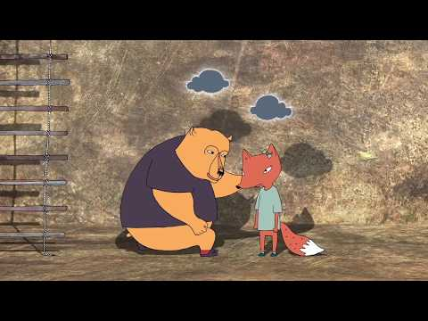
Notes:
2.30 mins
https://www.youtube.com/watch?v=HznVuCVQd10

Slide 19
Social skills
What are social skills?
Why are social skills important?
How can you support your child with this?
Lots of modelling.
Provide opportunities for your child to spend time with and socialise with other children
Praise your child for positive social behaviour.
Notes:
SAM - 1 mins
What are social skills?
Social skills are the ways in which we interact with others
They include verbal and non-verbal communication, such as speech, gesture, facial expression and body language.
Why are social skills important?
To have and maintain positive interactions with others.
To make and sustain friendships
Sharing, participating and accepting difference
Being able to solve difficulties in relationships and misunderstandings
What can you do to support?
Children learn from what they see. In order to develop social skills they need to see their parents caring, sharing, helping, comforting etc.

Slide 20
Communication skills
How can you support your child with this?
Support both talking and listening through play, sharing books, rhymes and songs.
Find opportunities for using words and initiating questions e.g. imaginary play / role-play as well as in day to day conversation
Use lots of modelling and targeted praise
What are communication skills?
Why are they important?
Notes:
SAM - 1 mins
What are communication skills?
The ability and want to connect with others by exchanging ideas and feelings, both verbally and non-verbally.
Communication can mean needs are met
Communication skills Includes things like listening, turn taking and speaking clearly
Why are they important?
Children need to be able to listen, understand and follow simple instructions and repeat words and phrases.
They need to be able to put their thoughts into words, be able to answer questions and communicate to build relationships
A child who has limited vocabulary and difficulty communicating will not be ready for school and will often lag behind their peers for the rest of their time in education – need for expressive and receptive language skills.
‘Without the ability to communicate effectively in speech and through reading and writing, children and young people are seriously disadvantaged for life.’ The Rose Review (see OFSTED)
How can you support?
Use of role play – adult models activities e.g adult pretending to be a doctor or nurse, modelling the kinds of questions that encourage children to respond. Children can extend role play using creativity and imagination. Child can reverse role in play when confident – lead activities. ‘Secure modelling’. – improves language skills/ communication.
Putting hand up in classroom.
Importance of promoting opportunities for children to speak in sentences and initiate questions, and of engaging in children’s imaginative role-play scenarios in communication development.
Communication development of children supported through parents talking and playing with their children every day, sharing book/ rhymes/ songs.

Slide 21
Routines
Why are routines important?
How can you support your child with this?
Routines to keep going at home:
The time to get ready in the morning
Bath times, mealtimes and bedtimes
Play time, reading, family time and outdoor play
‘Family rules’
Notes:
SAM - 1 mins
They are create a sense of anticipation and knowing what to expect which reduces anxiety
Routines also help parents maintain consistency of expectations that are thought out and enable the child to rely on them being followed through
Routines create a sense of predictability of care that children need.

Slide 22
Take home messages:
Promoting relationships and a secure base is important
Effective learning happens when children feel safe and settled
Important themes that support this transition can work across school and home
Notes:
Zainab - 1 min

Slide 23
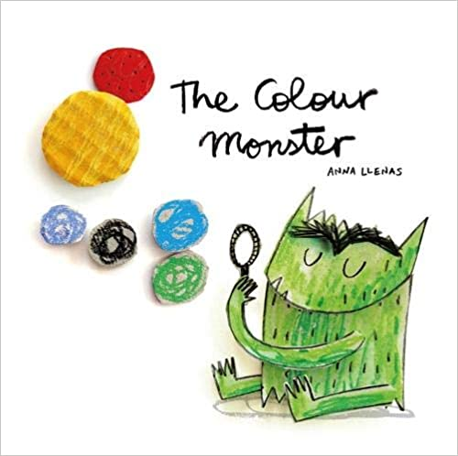
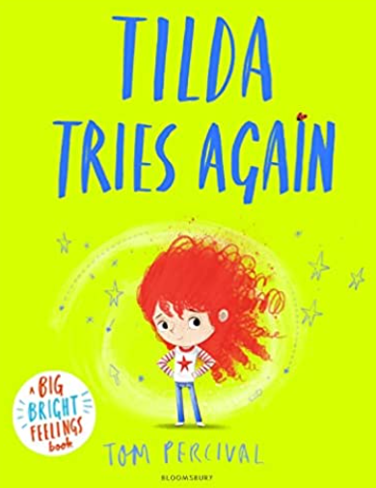
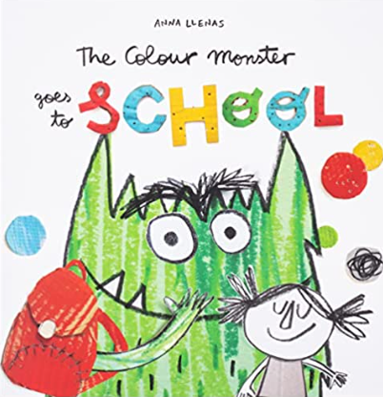
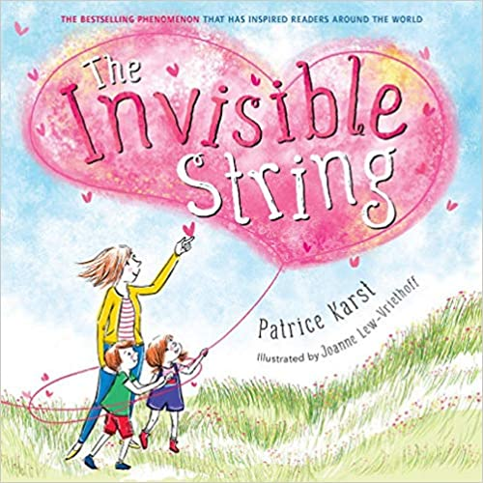
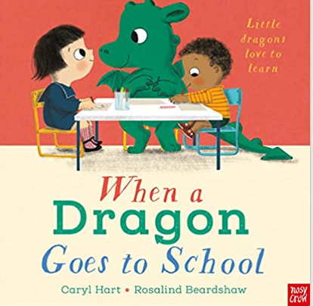
Resources:
Notes:
Zainab - 1 min
Tilda tries again - managing change, being brave and trying her best
https://www.youtube.com/watch?v=tVxGNElZ954
When a dragon goes to school
https://www.youtube.com/watch?v=i_AqhdSRsoY

Slide 24
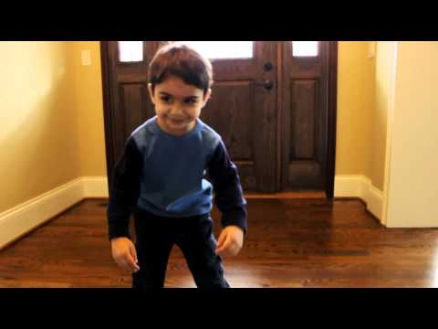
Notes:
30 seconds

Slide 25
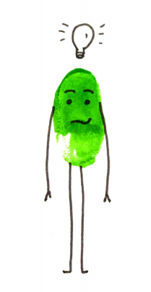
Questions - Ideas - Feedback

