Slide 1
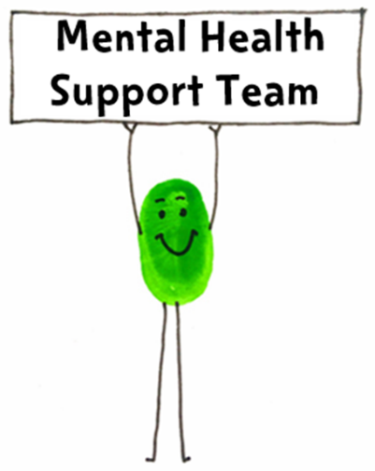
MHST Coffee Afternoon:
Talking to your child about
anxiety & worries
MENTAL HEALTH SUPPORT TEAM (MHST)
Emotional Health Service
Achieving for Children
42 York Street
London TW1 3BW
Notes:
Welcome
Purpose of today - an opportunity for you to find out more about the MHST and my role in the school; to get some ideas about supporting your child with worries or anxiety; and a chance for you to connect with other parents to share ideas

Slide 2
Plan for today…
Introducing the MHST
The cycle of anxiety
How to respond to worries
Further resources
Time to talk
Notes:
Run through timings and plan
Confidentiality - this is intended to be a safe space so please be mindful of what you share outside of here, and only share what you are comfortable to today. We’ll be talking about emotional wellbeing and mental health, which are topics that may be emotive at times for some people, so please do take care of yourselves. If there is something that may be triggering, please look after yourself.

Slide 3
Who are the MHST?
The Mental Health Support Team (MHST) is an early intervention, multi disciplinary team of clinical specialists, mental health clinicians (psychotherapists, counselling psychologists, art psychotherapists, drama psychotherapists, dance movement psychotherapists) and education wellbeing practitioners (EWPs).
We provide support for common mental health and wellbeing difficulties to children, young people, families/carers and staff in school settings, within Kingston and Richmond.
The teams are delivered by Achieving for Children as part of our Emotional Health Service.

Slide 4
What might this look like in my child’s school?
Education Wellbeing Practitioner based in your school one day a week, with flexibility for online work
Offering 1-1 brief guided self-help interventions for children with mild to moderate anxiety or behaviour difficulties
May also deliver group-work and workshops with groups or classes of children
Also running workshops for staff and parents e.g. (work coming up / planned)
For more information, speak to your class teacher or the school’s Mental Health Lead

Slide 5
The Cognitive Behavioural Model
Thoughts
Behaviours
Feelings
Physical responses

Slide 6
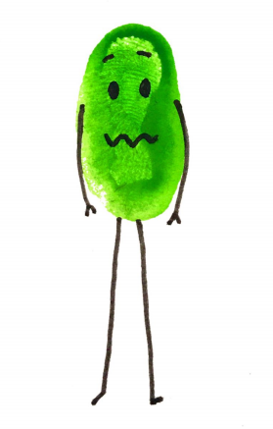
A vicious cycle
These responses create a vicious cycle that maintain anxiety
Thoughts
“Something bad might happen to me”
“What if my parents don’t pick me up from school?”
Behaviours
Avoid school
Check parents’ plans
Reassurance seeking
Feelings
Anxious
Worried
Sad
Physical responses
Heart racing
Shaky
Feeling sick
Headache

Slide 7
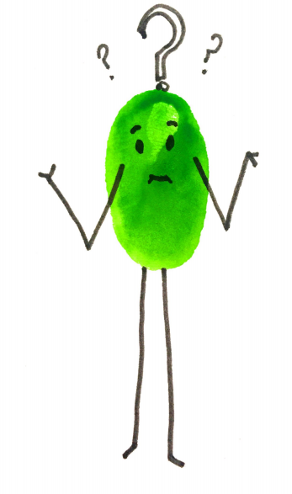
How can we help?
Notes:
We can help by breaking the cycle in different ways at all 4 levels - we’re thinking about putting on a longer workshop for parents on managing children’s anxiety, which will cover more of these strategies but a common concern for parents is knowing how to respond to their children’s worries.
A lot of parents tell us they don’t know what to say when their child is reassurance seeking or asking ‘what if?’ questions, and thinking about this can impact at various points in the cycle of anxiety.

Slide 8
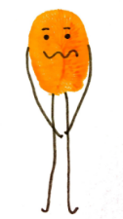
How can you help at home?
Don't be afraid to approach the child and ask if they are OK or if something is bothering them
Active listening is the best support you could offer
Wonder aloud about what might be happening for the child
Name feelings around events if they approach you to talk
Look beyond behaviour, be curious about what is happening for them
Model emotion regulation
Notes:
Don't be afraid to approach child and ask if they are OK or if something is bothering them
They might not always respond immediately but sometimes enough to know that you are there when they are ready to talk.
Listening is the best support you could offer
It is of course important to listen calmly, non-judgmentally and actively. If this is possible, find a quiet place and give them your full attention as this should enable a young person to speak freely and not feel judged. More tips on the next slide.
Wonder aloud about what might be happening for the child.
e.g. ‘I noticed you’re complaining of a tummy ache each morning, I’m wondering whether you’re worried about being away from me at school’.
It is always helpful to check whether you have understood correctly – by adding ‘Have I got that right?’
Name feelings around events if they approach you to talk.
e.g. ‘I can tell you looked really panicked when I said about me going out, I’m wondering why that was?’
Also useful to generally name feelings to build emotional literacy, not just is response to distress.
e.g. ‘I can tell from your face that you are very proud of that piece of work’
Look beyond behaviour, be curious about what is happening for them.
We want to understand why they’re feeling worried or anxious about something. What is it that is worrying them? If you think you have a good understanding, you can wonder aloud but always ask them whether you have got it correct.
Model emotion regulation
Teach young people that all emotions are ok, including emotions perceived as ‘negative’.
We can try and lead by example, it is easier to help children manage their own emotions when they see others around them manage their own.
Rather than one approach being THE solution, it is the combination of these approaches which have been shown to be helpful.

Slide 9
Talking tips
Asking questions – being curious:
“I wonder if you’re feeling ___ ?” “I wonder if you’re worried about ___?”
Empathising
“Those sound like some really difficult thoughts / feelings to be having”
Normalising, making suggestions
“Lots of children feel / think about ______ when they are worried. Is that like what’s going on for you?”
Check their understanding – “does that make sense?” but also yours – “have I understood that you feel ______ because of ______?”
Labelling emotions
“I can see that you’re feeling _____”
Make it fun or rewarding
Notes:
Here we have some tips for having conversations about worries, especially where children are feeling reluctant to talk about them.
Asking questions – being curious: This will elicit a deeper conversation than are you okay and provide understanding and hopefully a possible solution.
Empathising: We want to empathise and show understanding to the emotion without sympathising or agreeing with danger around situation (e.g. not ‘oh wow, going to school is really scary!’ but ‘Those sound like some really difficult thoughts / feelings to be having’
Normalising, making suggestions: Sometimes children can be reluctant to talk about their worries and may need some help to know that their worries are normal, or to start the conversation - if you aren’t quite right, they’ll usually correct you with what they’re actually thinking/feeling
Check their understanding – “does that make sense?” but also yours – “have I understood that you feel ______ because of ______?”
Labelling emotions which again will add to their emotional literacy skills.: This can be as simple as naming emotions, but there are other ways such as having a worry jar or worry monster, or somewhere else to write or draw worries and feelings, which I’ll talk about more on the next slide.
Make it fun or rewarding, if this is something they struggle with or haven’t done a lot of before making it fun or rewarding with charts or rewards will motivate them to have these conversations

Slide 10
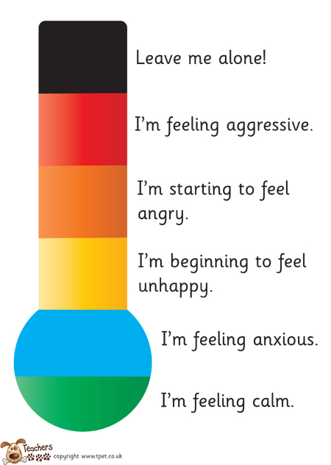
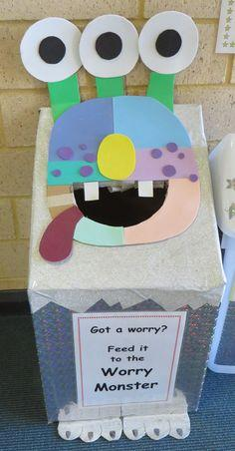
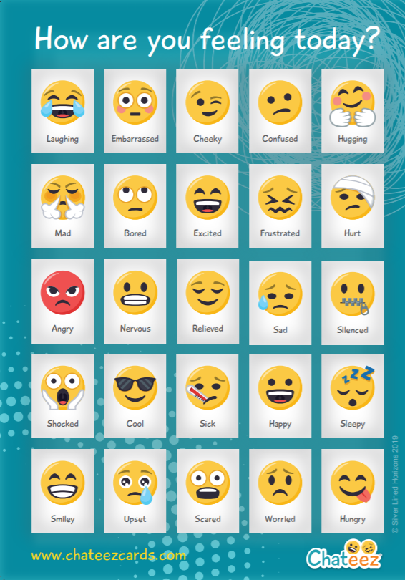
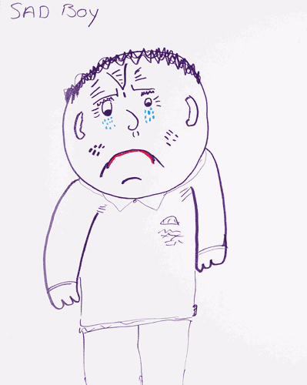
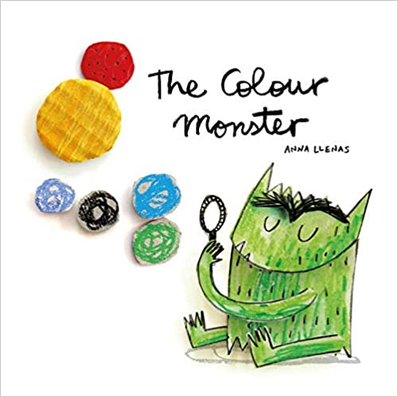
Notes:
Using resources to help support your child with emotional literacy can also help with the process.
You can encourage them to rate how their feeling from 1-10 and scale the feeling or worry they might be experiencing.
Drawing pictures of the feelings/worry – can be abstract as starting point e.g. how big is worry/ feeling? What colour is it? What shape?
Use of cards/ posters – can get key ring version that can put on lanyard.
Worry jar / worry monster - a way of writing down worries and ‘putting them away’ somewhere.
Some books are also great like ‘the colour monster’ for younger children or ‘starving the anxiety gremlin’ for older children.

Slide 11
Reassurance
Some children ask for reassurance about the same situation over and over again. Most parents already know that giving reassurance over and over again is not only exhausting but also doesn’t work.
This reassurance seeking ends up being a behaviour that, although well intentioned, only decreases anxiety in the short term, and actually ends up reinforcing the worried thoughts of the child that they cannot cope on their own.
It is not that we can never give reassurance but we can think about how much and when it is helpful. A helpful question to ask ourselves is whether the reassurance is helping the child to have a go at new things and test their fears, or if it’s stopping them from learning for themselves.
‘Will I be OK at school?’’
‘What if I can’t do it?’’
‘Are you OK?’’
Notes:
Some children ask for reassurance about the same situation over and over again e.g “will I be ok at school on my own?”
Most parents already know that giving reassurance over and over again is not only exhausting but also doesn’t work.
If we think back to the CBT cycle, our thoughts impact how we feel, what happens in our bodies and what we do. This reassurance seeking ends up being a behaviour that, although well intentioned, only decreases anxiety in the short term, and actually ends up reinforcing the worried thoughts of the child that they cannot cope on their own.
It is not that we can never give reassurance but we can think about how much and how often it is helpful. Otherwise the child can become dependent on this reassurance.
If we think back when we introduced the talking tips, wondering aloud, naming those feelings, always being curious. Just by using these tips and by gaining a better understanding of what they are anxious about will help in the long term.

Slide 12
What can we do instead?
A gradual approach to reducing reassurance:
You can agree to give only 1 item of reassurance per situation or daily (you decide)
Respond differently without giving reassurance. You can use the talking tips to find out more about what is worrying them, or use questions which help them to build their confidence and self-esteem and trust that they know the answer:
“You already know the answer to that question. I am not going to answer that.”
“It sounds like you are feeling worried, what can we do to help you feel a bit better - maybe some relaxed breathing? Are there any helpful thoughts that you can tell yourself?”
“What do you think? How could you handle that?”
Notes:
Instead we can take a gradual approach that encourages the child to learn they can cope and reduce reassurance seeking in a planned and predictable way:
Step 1: You can agree to give only 1 item of reassurance per situation or daily (you decide).
Step 2: Respond differently without giving reassurance. Each time a situation occurs and your child asks for reassurance, you can instead use questions which help them to build their confidence and self-esteem and trust that they know the answer e.g.:
“You already know the answer to that question. I am not going to answer that.”
“It sounds like you are feeling worried, what can we do to help you feel a bit better, maybe some relaxed breathing? Are there any helpful thoughts that you can tell yourself?”
“What do you think? How could you handle that?”

Slide 13
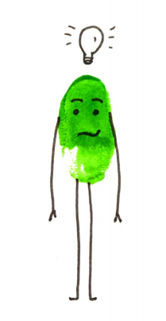
What has worked for managing your child’s worries?

Slide 14
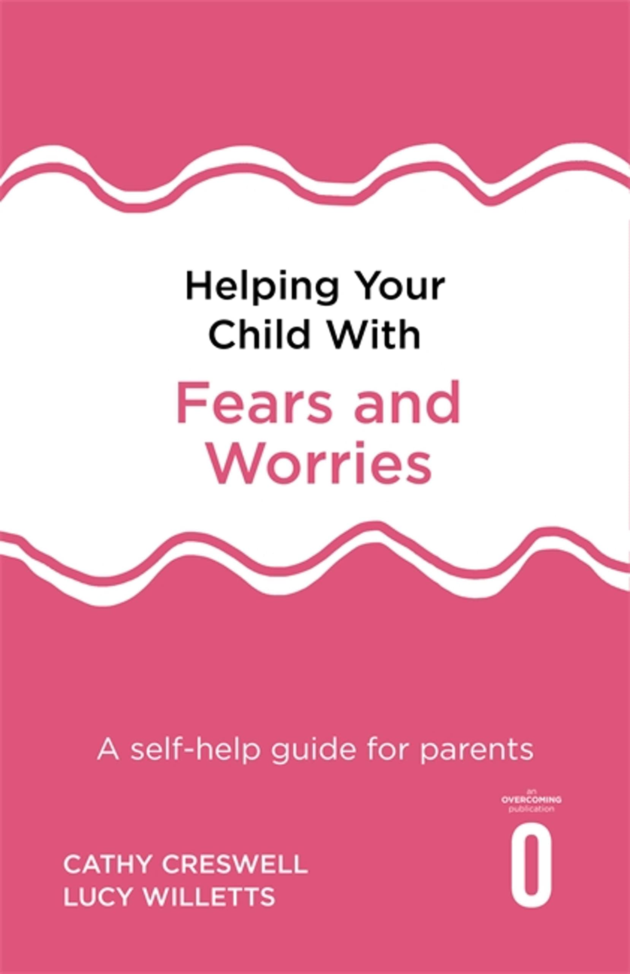
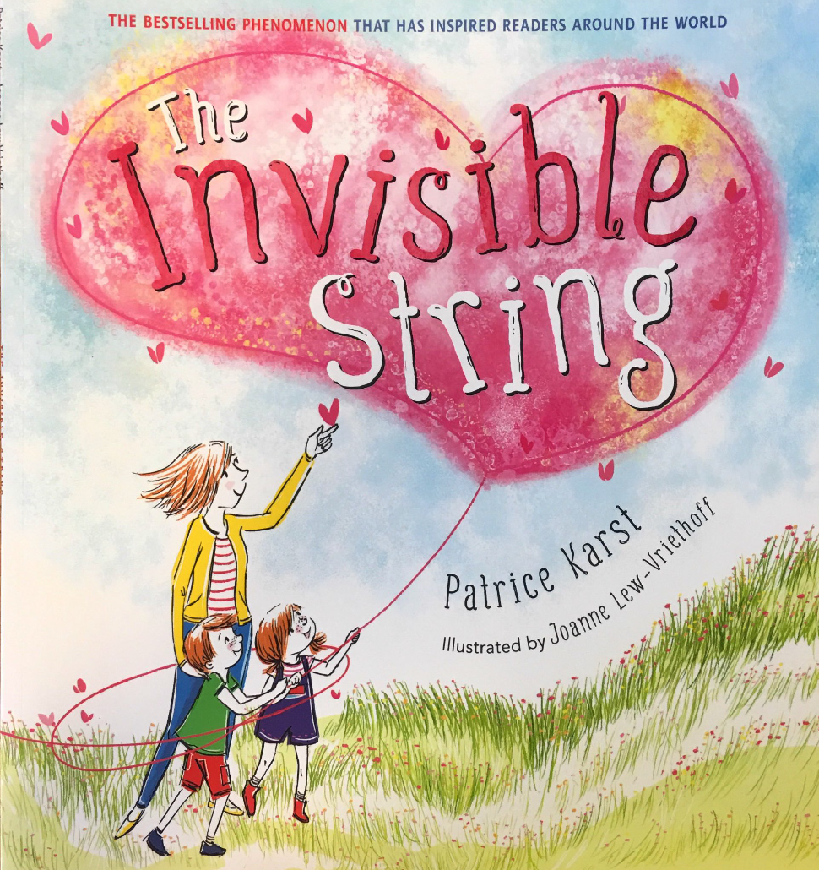
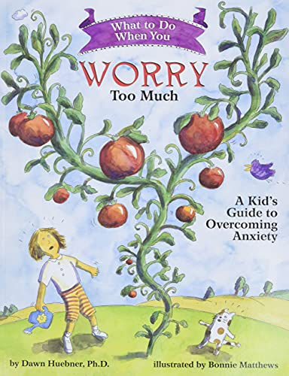
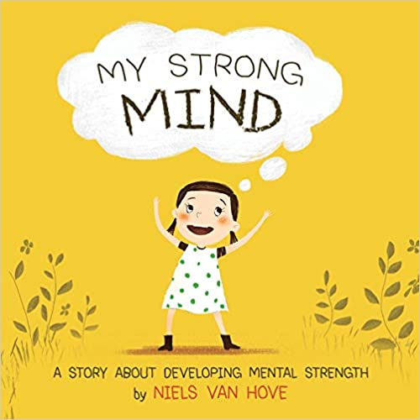
Further resources
Helping Your Child with Fears and Worries: A Self-help Guide by Cathy Creswell & Lucy Willetts
Anxiety Canada website
What To Do When You Worry Too Much by Dawn Huebner
The Invisible String by Patrick Karst
My Strong Mind books by Niels Van Hove
Headspace - app for mindfulness and relaxation

Slide 15
Questions - Ideas - Feedback
Feedback forms
Contact us on: mhstbusiness.support@achievingforchildren.org.uk
For further support please contact your child’s class teacher or the Mental Health Lead

