Slide 1
Anxiety; how to support your child’s emotional wellbeing
Lorren Khumalo
School Health Nurse

Slide 2
Agenda
What is anxiety?
What maintains anxiety?
Helping your child manage their anxiety
Resources/support

Slide 3
We may not be able to prepare the future for our children, but we can at least prepare our children for the future.
President Franklin D. Roosevelt

Slide 4
All of us have moments in our lives that test our courage. Taking children into a house with a white carpet is one of them.
Erma Bombeck

Slide 5
What is anxiety?
“a feeling of worry, nervousness, or unease about something with an uncertain outcome.”
An internal sense of fear, dread or worry
May or may not have an obvious cause
Fight or flight response

Slide 6
Common worries
Being away from parents/carers
Meeting new people
Going to new places
Going to school
Taking a test
Reading out loud
Taking part in a school assembly
Going to the doctor or dentist
Flying
Perfectionism
Fear of failure
Expectations
Unexpected changes

Slide 7
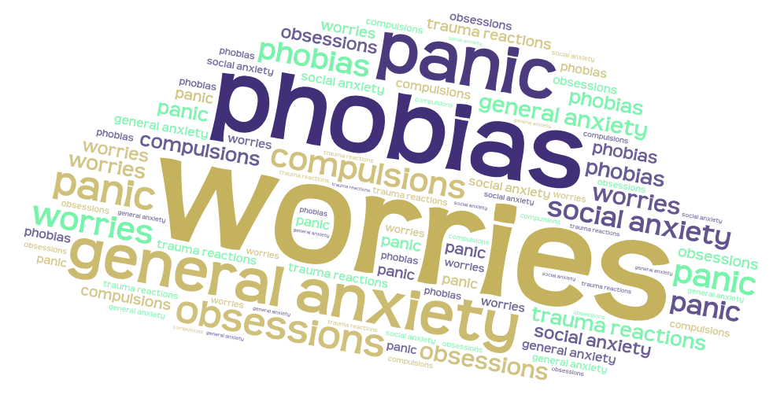
Forms of anxiety

Slide 8
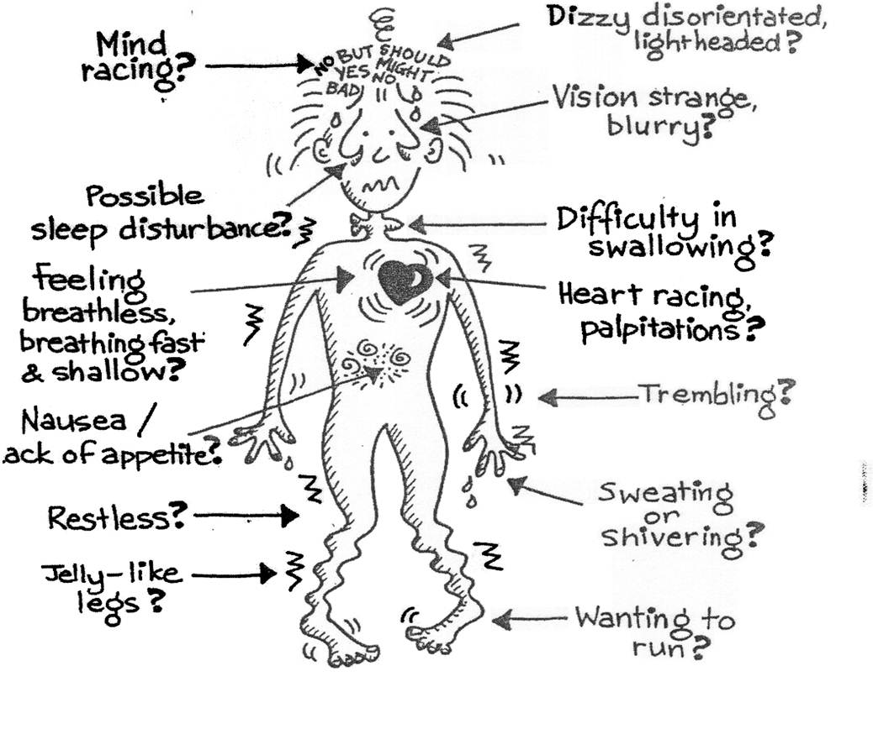

Slide 9
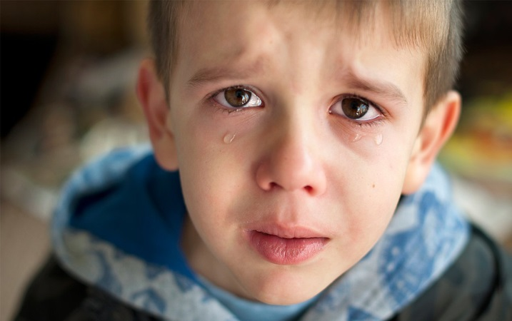
Common symptoms
Expressed fears/worries
Crying
Change in behaviours; avoidance or escape
Anger and rage
Disruption to sleep
Repetitive behaviours, thoughts or questions
Panic
Over estimating probability and /or consequences

Slide 10
Common physical symptoms
Faster breathing
Crying
Butterflies in stomach
Shaking
Sweating
Needing the toilet
Complaints of tummy ache or headache
Starting to wet the bed

Slide 11
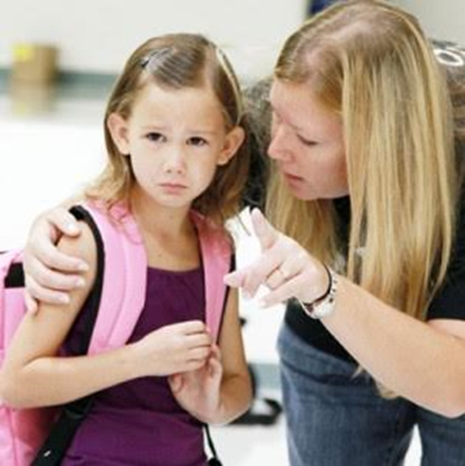
What maintains anxiety?
Allowing or encouraging avoidance
Lack of coping strategies
Excessive reassurance

Slide 12
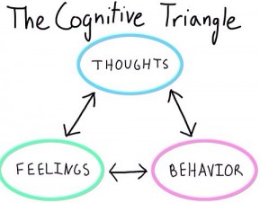
What maintains anxiety?
Trigger
I’m not good enough
Nobody likes me
Avoidance
Withdrawal
aggression
Fear
Worry
anger

Slide 13
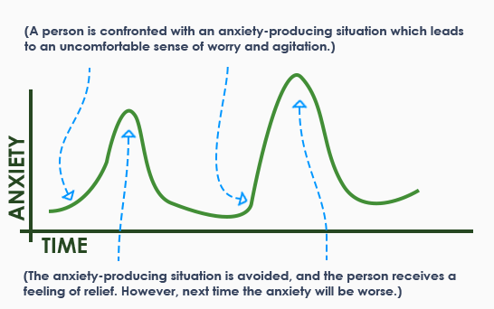
Avoidance

Slide 14
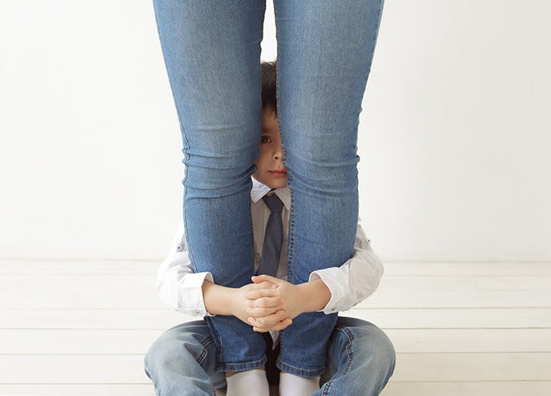
Avoidance
The dog walking towards you
The child hiding behind your legs

Slide 15
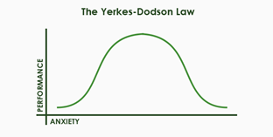
Anxiety v motivation
No anxiety- not bothered, will not prepare, will wing it
Moderate anxiety- I can do this but need to prepare and practice
High anxiety- I can not do it, I will look a fool, how can I get out of it, I feel sick

Slide 16
Most things are good, and they are the strongest things; but there are evil things too, and you are not doing a child a favour by trying to shield him from reality. The important thing is to teach a child that good can always triumph over evil.
Walt Disney

Slide 17
21st Century skills

Slide 18
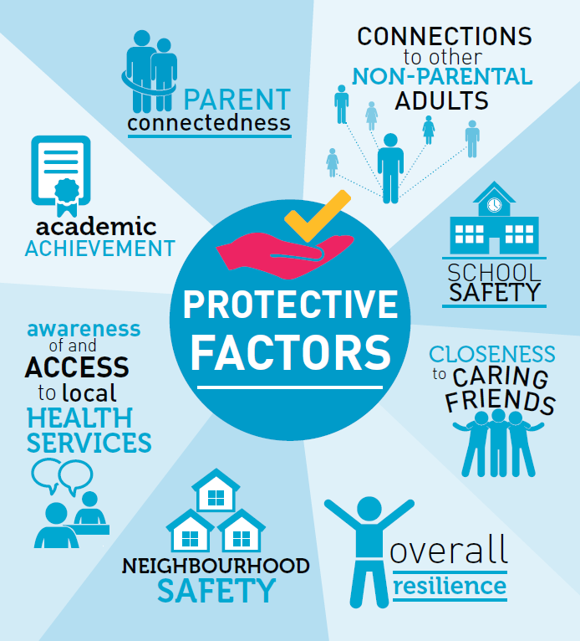
Protective factors

Slide 20
Helping children cope with anxiety
If we help change the way we think and act we can change the way we feel
What is the child thinking versus the real world
Encouraging resilience will
increase confidence

Slide 21
Helping children cope with anxiety
Good sleep, diet and exercise
Social interactions with family, friends, animals and nature
Building on strengths and interests
Avoiding doing too many activities
Ensure there is some down time
Reduce screen time

Slide 22
Coping strategies
Ability to calm down physically
Ability to talk through the situation
Problem solve and come up with an alternative plan

Slide 23
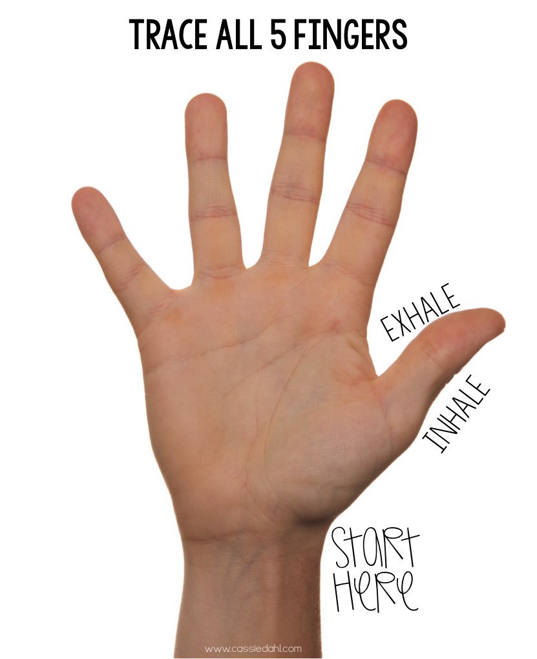
Relaxation techniques
Deep breathing exercises- finger breathing
Muscle relaxation- body mapping
Visualisation
Yoga
Meditation
Mindfulness

Slide 24
Calming techniques
Can you draw it?
Lets pretend to blow up a balloon, lets take a deep breath and blow it up to the count to five
What will happen next?”
If your children are anxious about an event, help them think through the event and identify what will come after it. Anxiety causes myopic vision, which makes life after the event seem to disappear.

Slide 25
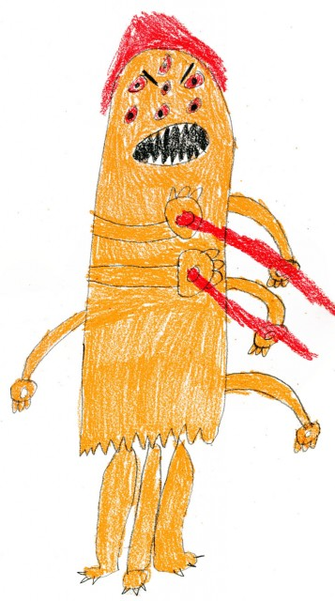
Calming techniques
“If how you feel was a monster, what would it look like?”
Giving anxiety a characterization means you take a confusing feeling and make it concrete and palpable. Once kids have a worry character, they can talk to their worry.

Slide 26
Facing fears
Slow small steps to face a particular fear
Face fears when feeling calm
Reward for facing fears
Reward the progress not the success

Slide 28
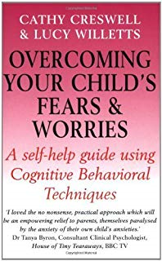
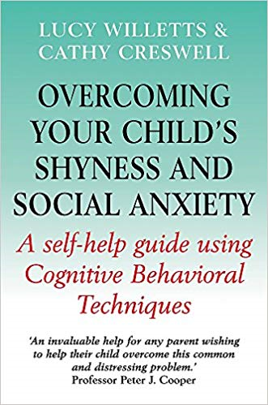
Additional resources
Cathy Creswell
CBT techniques and
strategies for parents

Slide 29
Additional resources
SAM
An interactive app to help and manage anxiety
Stop, breath & Think Kids
Help kids discover their
superpowers of quiet, focus and
peaceful sleep
Headspace
Guided meditation and mindfullness

Slide 30
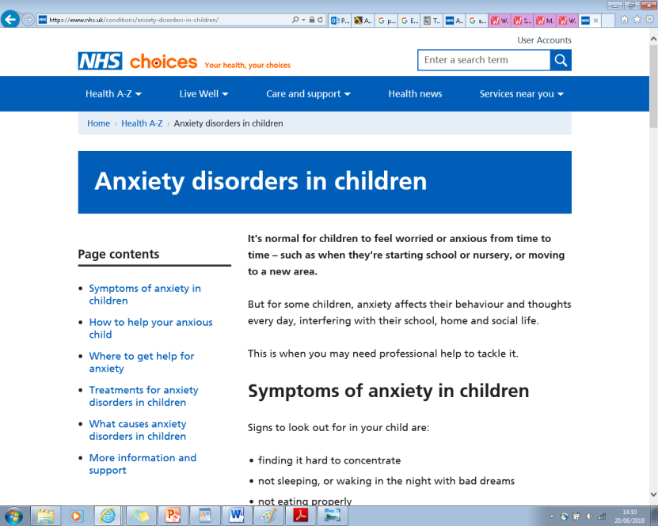
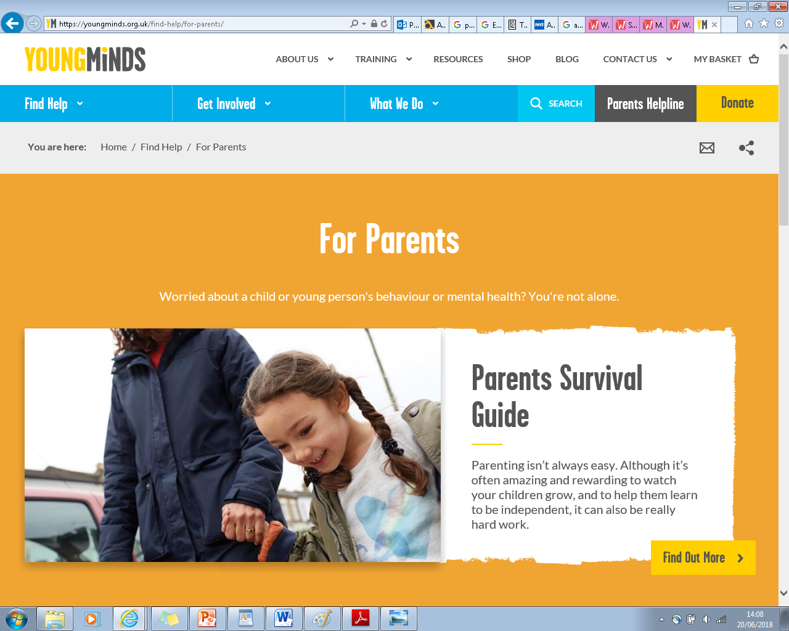
Additional resources
NHS choices
https://www.nhs.uk/conditions/anxiety-disorders-in-children/

Slide 31
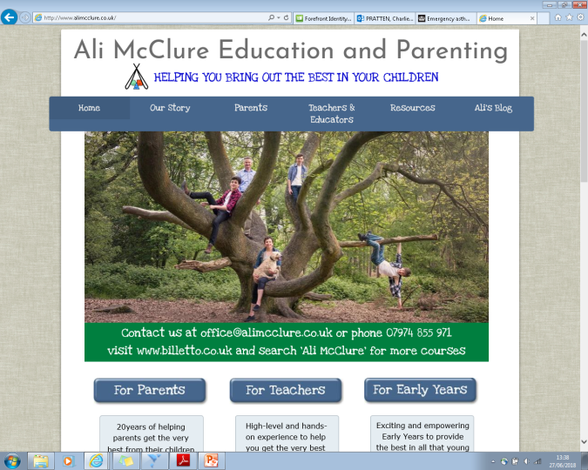
Parenting advice
Ali McClure
http://www.alimcclure.co.uk/
“Helping you bring out the best in your children”
Keystone Aspire; Dr Kathy Weston
http://www.keystone-aspire.com/
“Life is full of opportunities, lets ensure our children grasp them”

Slide 32
When to seek professional help
When strategies have been tried but do not help
Anxieties worsen or are severe
Parental anxieties
Child- parent relationship factors

Slide 33
Professional help
School nurse- for advice and self help strategies
School support- resilience and emotional support groups
Parenting advice and support
GP
Emotional wellbeing service

Slide 34
Richmond School Nursing Service
Self help strategies and advice
Signposting and referrals for further support
Named school Nurse
Charlie Pratten
0208 917 4220
Clcht.richmondschoolnursing@nhs.net

